Slide 1
The Society for the Exploration of Psychotherapy Integration (SEPI)
40th Annual Conference
April 2024
www.incip.cz

Slide 2
Integrated Psychotherapy/Knobloch A theoretical system with extensive application possibilities
Presented by:
PhDr. Iva Enachescu-Hroncová, PhD.
Mgr. Vladimír A. Enachescu, PhD.

Slide 3
Introduction
Presented by:
PhDr. Iva Enachescu-Hroncová, PhD.

Slide 4
The Bases of Integrated Psychotherapy (Knobloch)
Prepared by:
PhDr. Iva Enachescu-Hroncová, PhD.
Presented by:
Mgr. Vladimír A. Enachescu, PhD.

Slide 5
The Bases of Integrated Psychotherapy (Knobloch)
Philosophical background
From Freud’s family taboo to family psychotherapy
From mentalism to the concept of the whole organism
From a therapeutic community to a psychotherapeutic community
From the system of one person to the system of a small social group
Mental life as a group process: Group schema
Social exchange
Musical experience as an interpersonal process
Contributions of evolutionary psychology
The future of Integrated Psychotherapy

Slide 6
The Bases of Integrated Psychotherapy (Knobloch)
Philosophical background

Slide 7
Decrease of Neurotic Symptoms

Slide 8
Harmful Traits Scale Totals

Slide 9
Harmful Traits Change Scores

Slide 10
Reduction of Harmful Traits

Slide 11
The Bases of Integrated Psychotherapy (Knobloch)
From Freud’s family taboo to family psychotherapy

Slide 12
The Bases of Integrated Psychotherapy (Knobloch)
From mentalism to the concept of the whole organism

Slide 13
Real Father

Slide 14
Ideal Father

Slide 15
Ideal + Real Father

Slide 16
The Bases of Integrated Psychotherapy (Knobloch)
From a therapeutic community to a psychotherapeutic community

Slide 17
The Bases of Integrated Psychotherapy (Knobloch)
From the system of one person to the system of a small social group

Slide 18
The Bases of Integrated Psychotherapy (Knobloch)
Mental life as a group process: Group schema

Slide 19
Group Schema

Slide 20
The Bases of Integrated Psychotherapy (Knobloch)
Social exchange

Slide 21
The Bases of Integrated Psychotherapy (Knobloch)
Musical experience as an interpersonal process

Slide 22
Circumplex

Slide 23
The Bases of Integrated Psychotherapy (Knobloch)
Contributions of evolutionary psychology

Slide 24
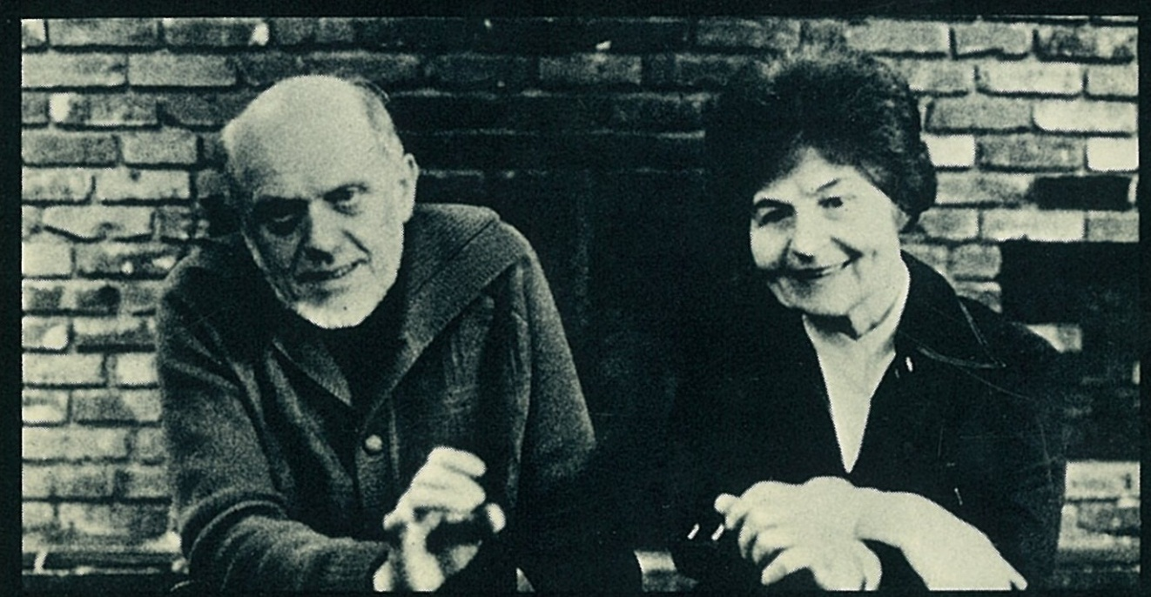
The Bases of Integrated Psychotherapy (Knobloch)
The future of Integrated Psychotherapy
Prof. MUDr. Ferdinand Knobloch, CSc. (Czech), F.R.C.P (Canada) Prof. MUDr. Jiřina Knoblochová, CSc.

Slide 25
HOW IS IP VIEWED BY OTHERS?
“For maximal eﬀectiveness, a psychotherapeutic program should have the following characteristics… Improbable as it may seem, the system of Integrated Psychotherapy presented in this book approaches such an ideal. That this can be said attests to the unusual, if not unique, qualiﬁcation of Ferdinand and Jirina Knobloch…”
Jerome D. Frank, MD, PhD, Professor Emeritus of Psychiatry, The University of Johns Hopkins, Medical School, Baltimore
Foreword. F.Knobloch & J. Knobloch, Integrated Psychotherapy. New York: J. Aronson, 1979, XI.

Slide 26
Thank You for Your Attention

Slide 27
Contact us
Current director of INCIP: Iva Enachescu-Hroncová, Ph.D.
E-mail address: incip@volny.cz
www.incip.cz

